Slide 1
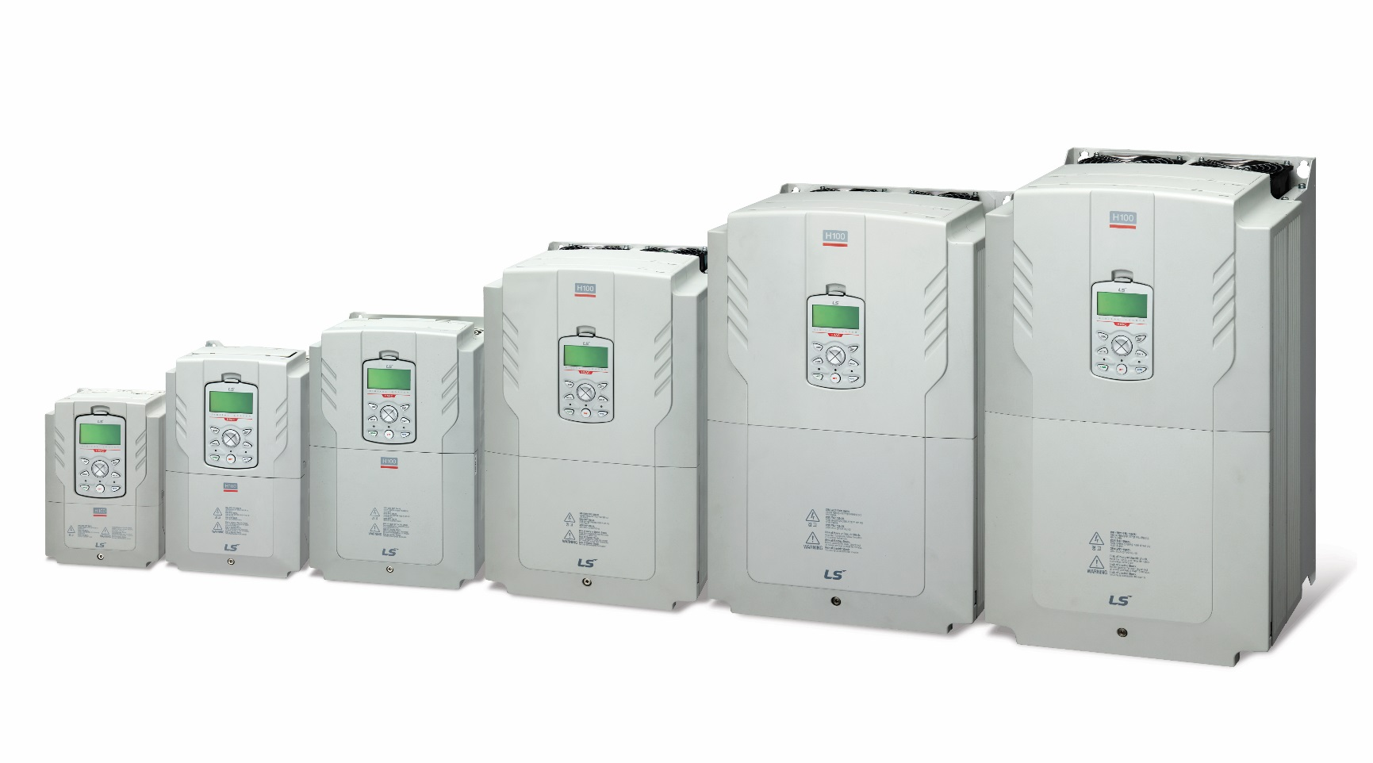
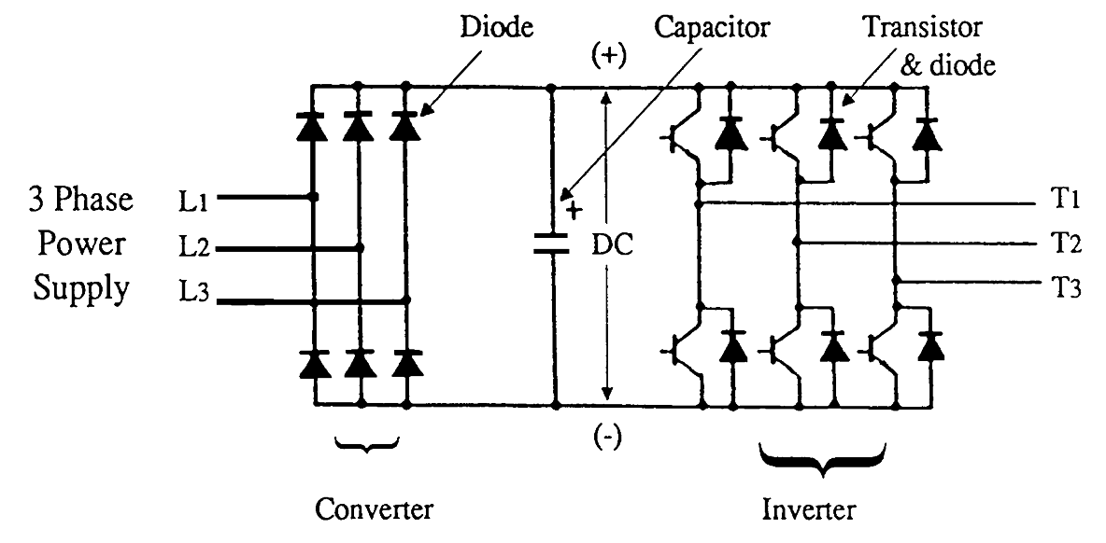
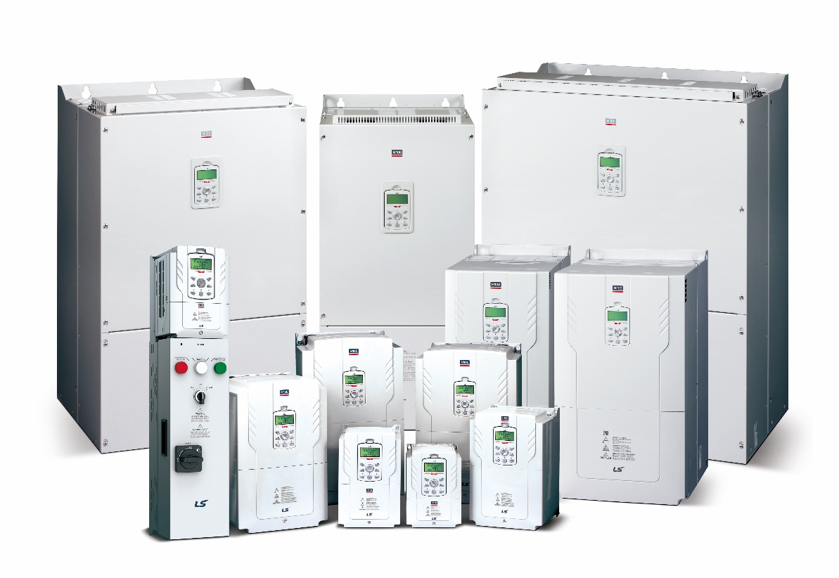
VFD Basics
Class Name: LS VFD Basics
Version: 1.10
Date: 3/30/2020

Slide 2
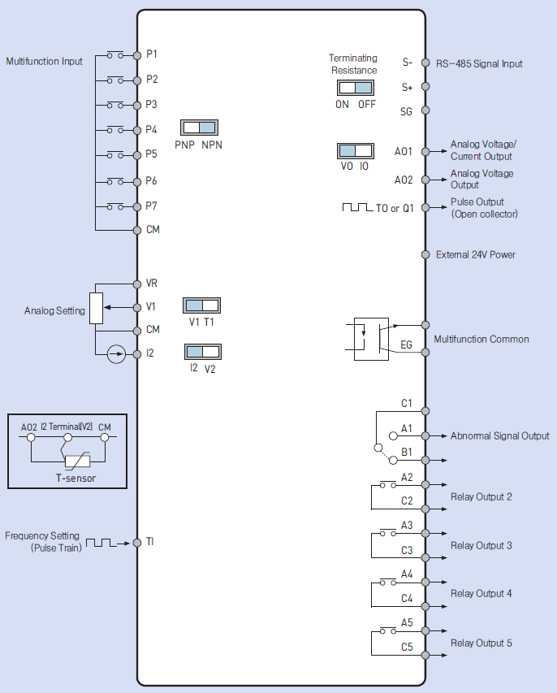
Principles VFD Basics
Wiring Connection Diagram
I/O is used for the control and monitoring of the VFDs operation and status.
Examples….
Start/Stop
Speed control (analog or digital)
Analog meter (speed monitoring)
Communications
Output contacts for fault, run, speed status, etc.
The I/O terminals typically consist of and interface with 24VDC, 4-20mA, 0-10VDC, and other low voltage signals.

Slide 3
Principles VFD Basics
VFD Sections
Hey, G100! Go faster!
The main power sections of the VFD are necessary to convert constant frequency and voltage to variable frequency and voltage.
This allows us to control motor speed and torque!
Input
Converter
Non-Regulated Rectifier
DC Voltage
Inverter
Voltage Controlled
Output
AC Input Voltage
Variable Frequency
Variable Voltage
Constant V/f

Slide 4
Principles VFD Basics
Principle 1 – Main Components
The VFD changes (rectifies) AC power to DC power and then changes (inverts) it back to AC power.
AC
DC
AC

Slide 5
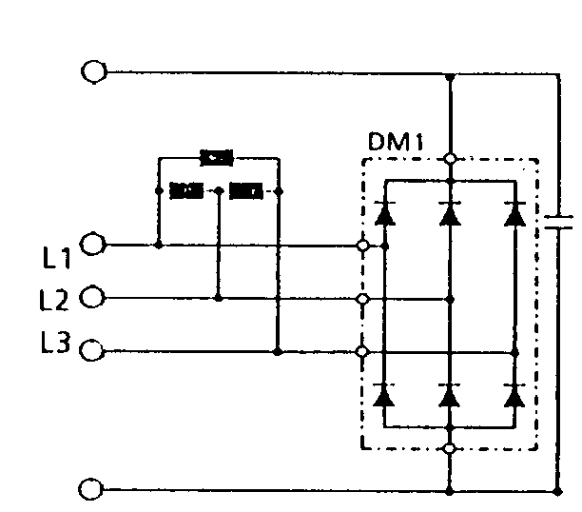
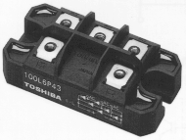
Principles VFD Basics
Converter Section
The converter section is made up of diodes that convert the AC input voltage to DC voltage.
+
Cathode (-)
Anode (+)
-
Schematic diagram

Slide 6
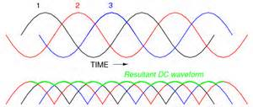
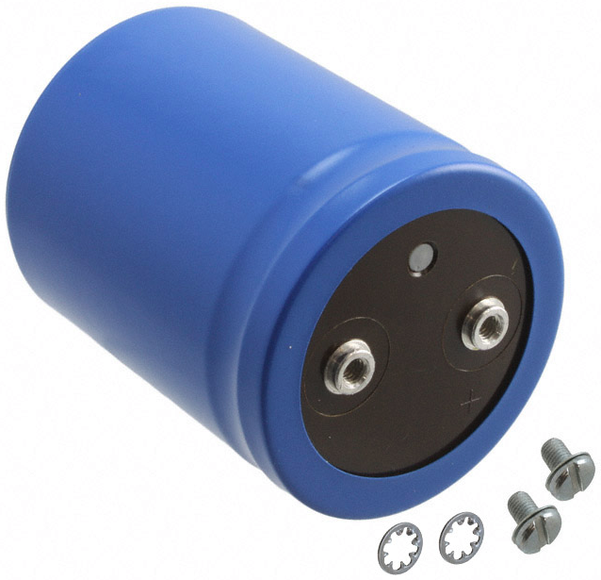
Principles VFD Basics
DC Bus Section
The DC bus consists of capacitors used to smooth and store DC voltage.
DC Bus Voltage = Vin*1.414
AC to DC Conversion
+
+

Slide 7
Principles VFD Basics
DC Bus Section
The DC bus is protected by a soft charge circuit. The circuit utilizes a resistor and contactor to “softly” charge the DC bus capacitors on power up.
Soft Charge Sequence
Current flows through the resistor which limits inrush to the capacitors.
The undervoltage level is reached and the contactor closes. This bypasses flow through the contactor instead of the resistor.
Soft Charge Contactor
Output Transistors
Input Diode
Soft Charge Resistor
+
3 phase input
DC Bus Capacitors
Fuse
Simplified VFD Circuit

Slide 8
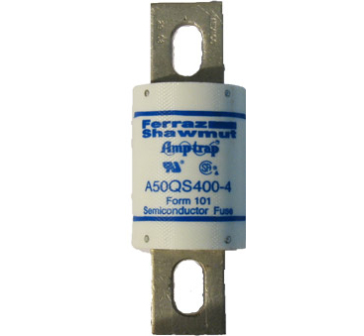
Principles VFD Basics
DC Bus Section
Some VFDs have a DC bus fuse which is used to protect the power components when then output shorts or fails.
Soft Charge Contactor
Output Transistors
Input Diode
Soft Charge Resistor
+
3 phase input
DC Bus Capacitors
Fuse
Simplified VFD Circuit

Slide 9
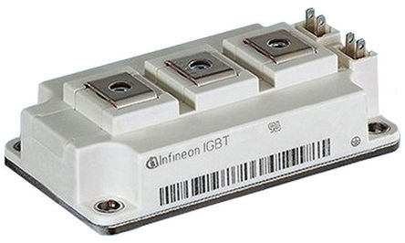
Principles VFD Basics
Inverter Section
The inverter section consists of rapid firing insulated gate bipolar transistors (IGBTs). The IGBTs are utilized as switches to switch the voltage ON and OFF to the connected motor.

Slide 10
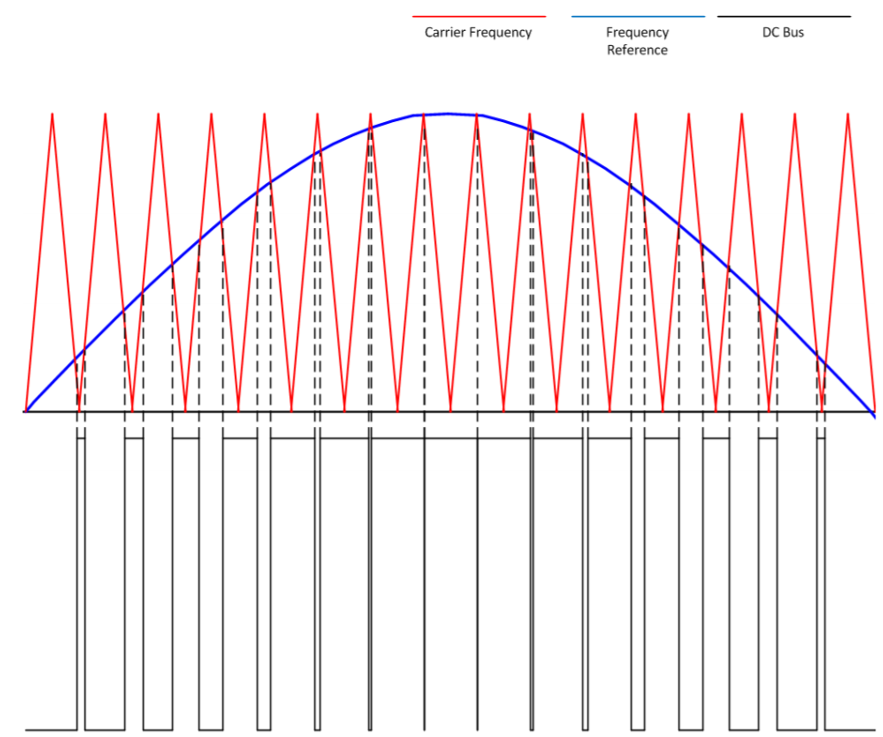
Principles VFD Basics
Inverter Section
The rapid firing IGBTs “chop” up the DC bus voltage to reconstruct a pseudo sine wave. This is called Pulse Width Modulation (PWM)
The rate at which the IGBTs switch is called the carrier frequency.

Slide 11
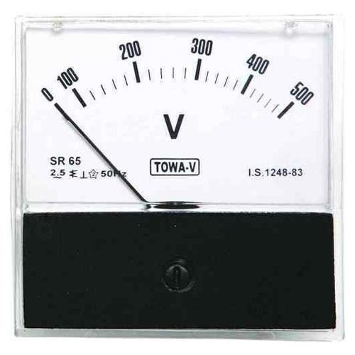
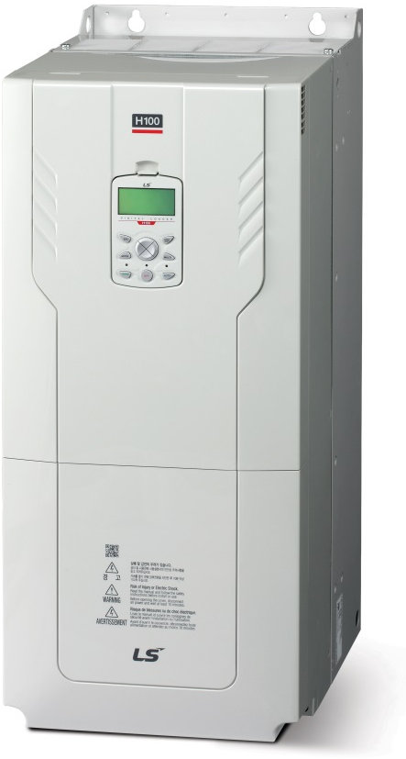
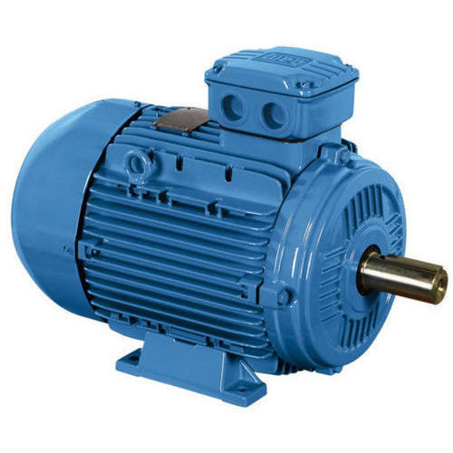
Principles VFD Basics
Principle 2 - PWM
The output voltage to the motor is adjusted by modulating the width of the output pulses which make up the output voltage waveform via PWM.
The higher the ratio of ON time as compared to the switching time results in a higher voltage.
Ton
= 50%
Tc
Ton
Tc
Ton: Length of time the transistor is on
Tc: Switching time

Slide 12
Principles VFD Basics
Principle 2 - PWM
More ON time means higher output voltage.
Ton
Ton
Ton
= 75%
= 90%
= 50%
Tc
Tc
Tc
Ton
Ton
Ton
Tc
Tc
Tc
Ton: Length of time the transistor is on
Tc: Switching time

Slide 13
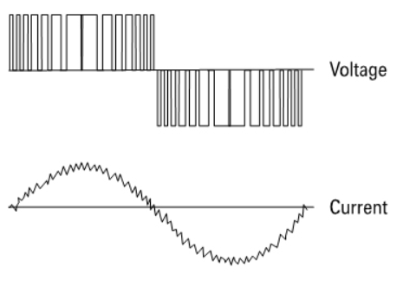
Principles VFD Basics
Principle 2 - PWM
Question: How can an AC motor possibly run on this PWM output?
Answer: An induction motor is…an inductor! An inductor resists the change in current. Even though the output voltage waveform is a PWM square wave, the current is sinusoidal!

Slide 14
Principles VFD Basics
Principle 3 – Speed Torque Curve
Speed Torque Curve for an “across the line” start.
(300%)
(600%)
Slip
TORQUE
CURRENT
Breakdown Torque (200-250%)
(300%)
(200%)
Pull Up Torque (125%)
Locked Rotor Torque (150%)
Full Load Torque (100%)
No Load Current (30%)
SPEED
Rated Speed
Synch Speed

Slide 15
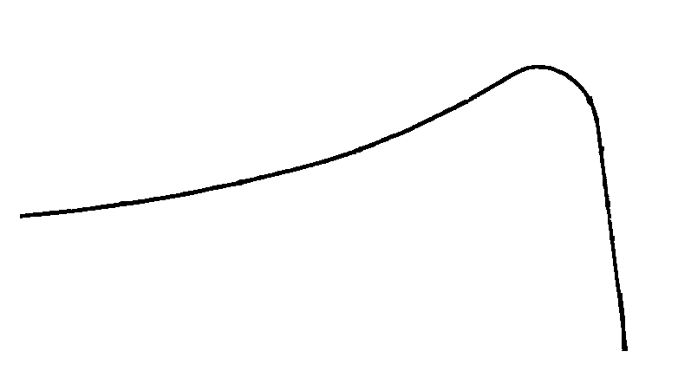
Principles VFD Basics
Principle 3 – Speed Torque Curve
Torque production when connected to an inverter.
TORQUE
Locked Rotor Torque (150%)
Full Load Torque (100%)
Fout (Hz)
60

Slide 16
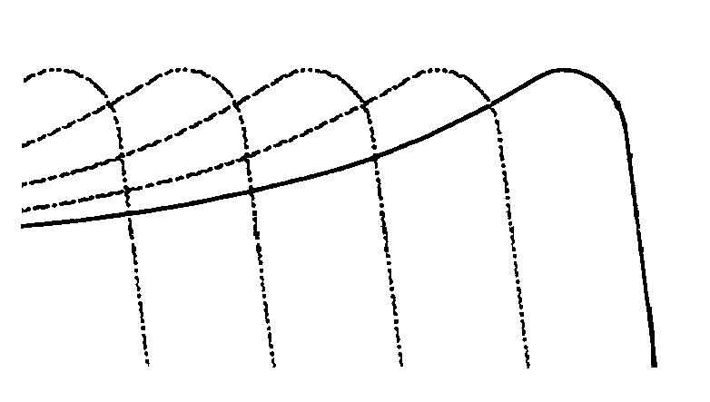
Principles VFD Basics
Principle 3 – Speed Torque Curve
Torque can be controlled at any speed with an inverter to meet application demands!
TORQUE
Locked Rotor Torque (150%)
Full Load Torque (100%)
3.0
Fout (Hz)
60

Slide 17
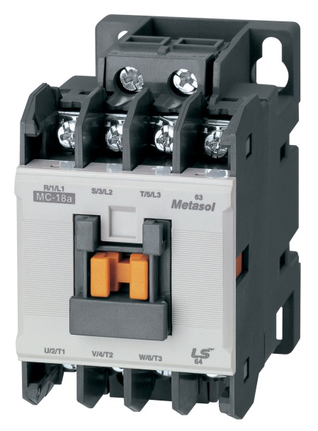
General Topics VFD Basics
Topics of Discussion
MCCB Current Rating and Selection
Single Phase Input
Motor Overload Protection
Operating Multiple Motors
Input/Output Contactors
High Altitude Derating
Input/ Output Reactors
DC Link Chokes
NEMA Enclosure Ratings

Slide 18
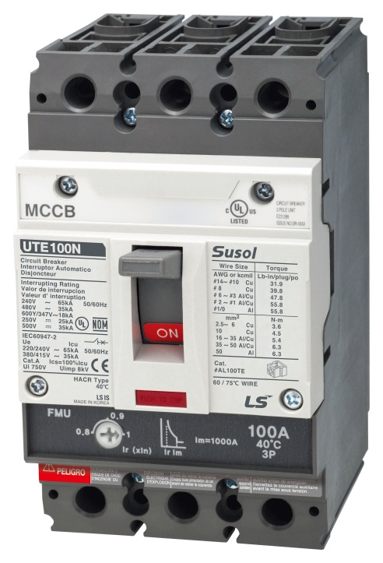
MCCB Current Rating and Selection VFD Basics
Rule of Thumb:
MCCB ≥ 150% of drive input current rating
Iin=
Where: I_{in} = Input fuse/MCCB Rating V_{inv} = Inverter rated output voltage Ii_{nv} = Inverter rated output current x 150% V_{in} = Nominal input voltage Pfs = Power system power factor Pfm = Motor power factor
V_{inv} x Pfm x I_{inv}
Vi_{n} x Pf
Note: All sizing for MCCBs, Fuses and MMS paired with LS VFDs has been done by LS! See the document on www.LSElectricAmerica.com titled “Fuse, CB, and MMS Sizing for LS VFDs Supplemental Bulletin”

Slide 19
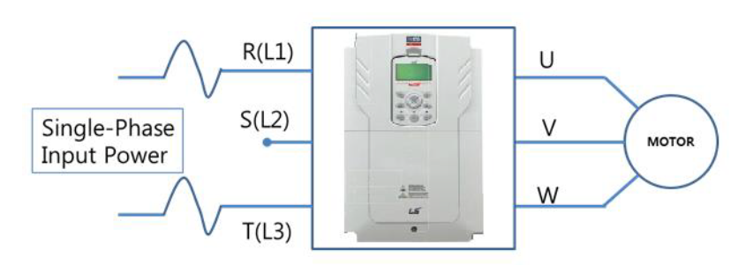
Single Phase Input VFD Basics
All LS VFD series can operate off of a single-phase input. The VFD acts as a phase converter to run a three-phase motor.
Some LS VFD series, with a “-1” in the model # are dedicated for single-phase input use.
For standard three-phase input VFDs, a general 50% derate can be applied when sizing.
LS has UL tested single-phase derate tables available!
But why do we have to derate?

Slide 20
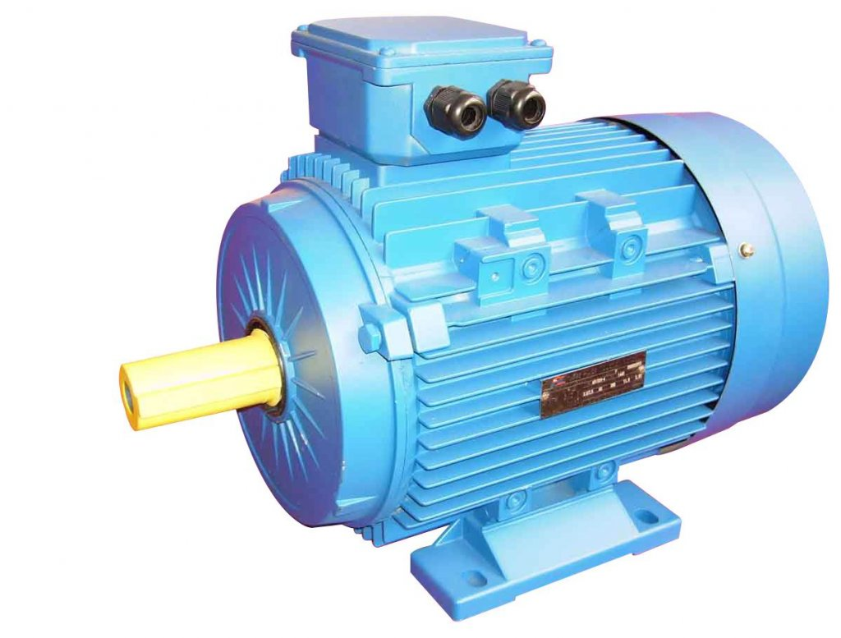
Motor Overload Protection VFD Basics
VFDs include electronic thermal overload protection for the motor.
The overload is adjusted to the motor current via parameters.
This eliminates the need for an external overload for motor protection.

Slide 21
Operating Multiple Motors VFD Basics
When more than one motor is driven in parallel with a single VFD, select the capacity so that…
Operating multiple motors requires separate overloads for each motor and the VFD must be programmed for V/f.
OLR
OLR
VFD Output Current ≥ Total Motor FLA x 1.1
OLR
OLR
T1-Temp
Proportional (PID) Control
VFD

Slide 22
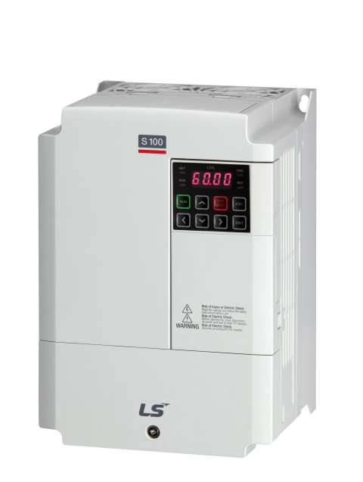
Excessive Switching VFD Basics
Transformer
The recommended maximum switching of the input of the VFD is 2 times per minute.
Pre-charge circuits can heat up causing premature failure when exceeding this recommendation.

Slide 23
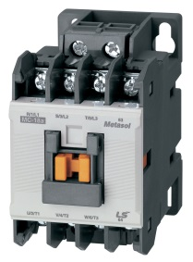
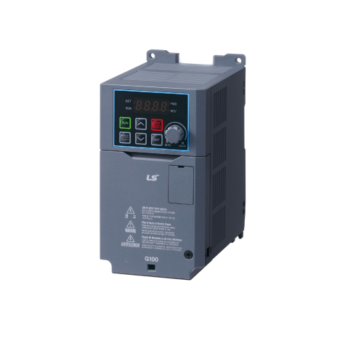
Input/Output Contactors VFD Basics
Input Contactors
A VFD can be operated without an input contactor.
Do not use an input contactor to start and stop the drive.
Instead use terminal run commands or alternative start/stop controls through the VFDs I/O.
Output Contactors
A VFD can also be used without an output contactor.
Opening or closing an output contactor while the VFD is running can cause damage and failure to the VFD.

Slide 24
High Altitude Derate VFD Basics
Power conversion equipment must be derated above a certain altitude.
LS VFDs are rated to 3300 feet (1000 meters) in altitude and 40 degrees C. Derate is about 3% for every 1000ft (300M) above that.
Hey! I hope you derated that drive!

Slide 25
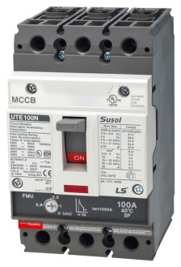
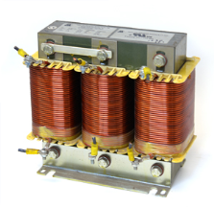
Input Reactors VFD Basics
Problem
Stray voltages, spikes, and transients can damage a VFD.
Imbalanced phases can also cause stress on filter capacitors or trigger various faults.
The closer your application is to the maximum load of the VFD the more sensitive it becomes to a voltage imbalance.
Current Harmonics.
Solution
Use a three-phase input reactor when the power source transformer (KVA) is very large compared VFD capacity (KVA).
Also used when the power factor needs to be improved.
Can reduce current harmonics from 85% down to 30-35%.
See you on the other side!

Slide 26
Output Reactors VFD Basics
Problem
Long lead lengths causing reflective (standing) waves.
Low impedance motor is used.
Solution
Use a three-phase output reactor to filter the spikes on the output PWM waveform. And output reactor will also add additional impedance.
Hi again!
M

Slide 27
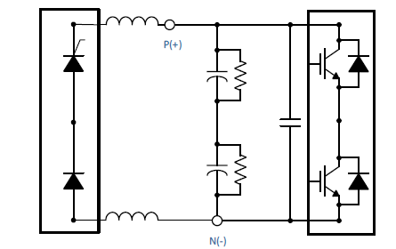
DC Reactors VFD Basics
DC Reactors (DC link chokes) are used when the power source transformer (KVA) is very large compared to the VFD capacity (KVA).
DC Reactors improve VFD power factor and mitigate bus ripple caused by a single phase input.
Larger VFDs tend to have built in DC reactors while smaller VFDs would need one installed.
A 150HP H100 with two built-in DC link chokes.

Slide 28
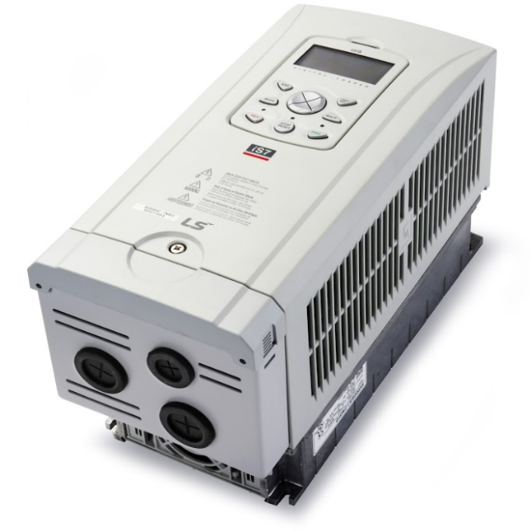
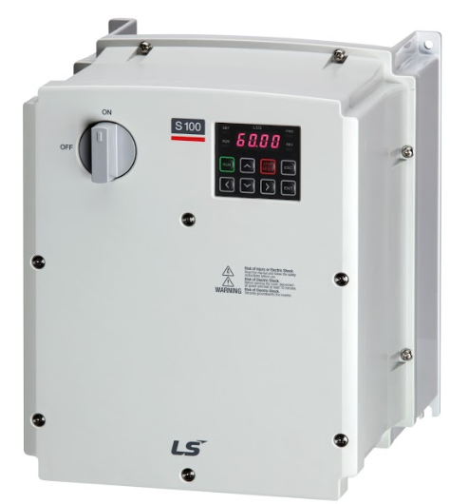
NEMA Ratings VFD Basics
iS7 with NEMA 1 Kit
S100 NEMA 4X

Slide 29
Closing VFD Basics
Thank You!
For a copy of these slides or for any technical questions…
Contact your local Gilson Sales person.

